Slide 1

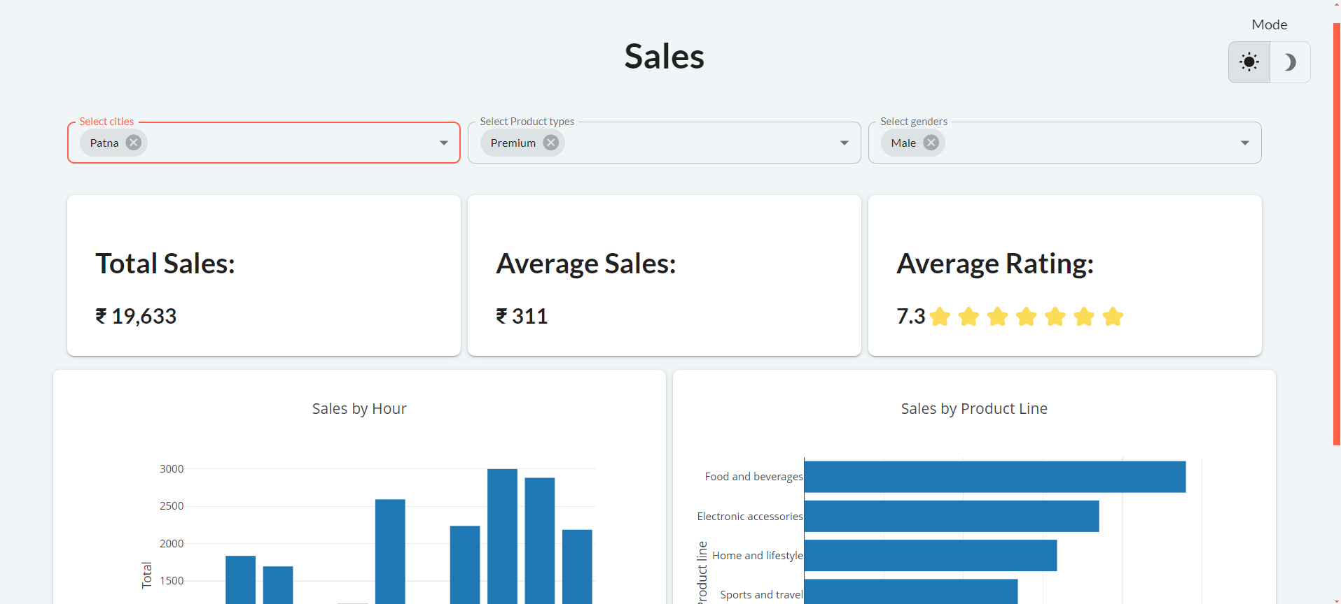
Introduction to the Sales Dashboard
This sales dashboard provides a comprehensive view of your business's performance, empowering you to make informed decisions and drive growth. Dive into the detailed analysis and visualizations to uncover insights that will help you optimize your sales strategy.

Slide 2

What is Data Cleaning and Its Tools
1
Data Cleaning
2
Data Cleaning Tools
The process of identifying and correcting errors, inconsistencies, and missing values in your data to ensure its accuracy and reliability.
Powerful software like Excel, Tableau Prep, and OpenRefine that automate data cleaning tasks and help you transform your raw data into a high-quality dataset.
3
Benefits
Improved data integrity, enhanced decision-making, and better-informed business strategies.

Slide 3
Key Metrics: Average Sales, Total Sales, and Product Ratings
Average Sales
Total Sales
Product Ratings
Understand the typical sale value to identify opportunities for upselling and cross-selling.
Track overall revenue and identify the best-performing products or time periods.
Evaluate customer satisfaction and identify areas for product improvement or development.

Slide 4
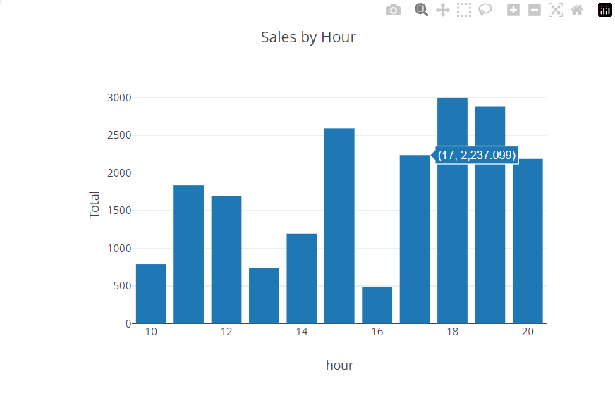
Gender Selection
1
Male
Our core customer base, focused on functionality, performance, and technical specifications.
2
Female
A growing segment interested in design, user experience, and lifestyle integration.

Slide 5




Sales by Hour: Analyzing Hourly Sales Patterns
Morning Peak
Afternoon Dip
Evening Surge
High sales of General Products during the morning hours, indicating a need for increased staffing and product availability.
Lower sales during the mid-afternoon, suggesting opportunities for targeted promotions or activities to boost engagement.
Spike in sales towards the end of the day, highlighting the importance of maintaining product stock and staffing levels during this critical time.

Slide 6




Interactive Graphs and Charts
Bar Charts
Line Charts
Pie Charts
Scatter Plots
Visualize sales data by category or time period.
Track sales trends and identify patterns over time.
Analyze the distribution of sales across products or regions.
Identify relationships between variables, such as sales and customer demographics.

Slide 7
Insights and Recommendations
Seasonal Trends
Product Performance
Leverage the identified seasonal sales patterns to optimize inventory, staffing, and marketing strategies.
Identify underperforming products and explore ways to improve their sales, such as product updates or targeted promotions.
Customer Engagement
Data-Driven Decisions
Analyze the hourly sales patterns to enhance the customer experience and drive higher engagement during low-activity periods.
Utilize the interactive visualizations to quickly identify trends, opportunities, and areas for improvement.

Slide 8
Conclusion and Next Steps
The sales dashboard provides a comprehensive view of your business's performance, enabling you to make informed decisions and drive growth. By leveraging the insights and recommendations, you can optimize your sales strategies, enhance the customer experience, and achieve greater business success.
As you move forward, continue to monitor the dashboard, explore new data visualizations, and collaborate with your team to identify areas for continuous improvement. The power of data-driven insights will be your guide to unlocking the full potential of your sales operations.

